Slide 1
STUDENT WORK PRESENTATION
- Aashika Chakravarty

Slide 2
PROBLEM STATEMENT & MOTIVATION
The pandemic has made it almost essential to avoid places with a high volume of people. Gyms are no exception.
This makes it essential to plan workouts based on the number of people in the gym at a certain given time
One solution to this problem is a crowd monitoring system that can be checked remotely

Slide 3
PROJECT OVERVIEW
This is an IOT-Based RFID Crowd Analyser using Raspberry Pi and Arduino Uno
Several variables are being monitored like the temperature, humidity, number of people inside, and time of day, which controls the lighting and fans of the gym.
A Cloud API was used to provide online statistics for remote monitoring

Slide 4
COMPONENTS AND CONNECTIONS
Main Components used
Raspberry Pi 3
Arduino Uno
RFID Scanner (MFRC522) and RFID Tags
DHT-11 Sensor
Photoresistor
LEDs
Motor (fan)
Jumper cables, Breadboard, Resistors

Slide 5
COMPONENTS AND CONNECTIONS
Raspberry Connections:
RFID Scanner
DHT-11 Sensor (Temperature and Humidity)
Interface to communicate with Arduino (using Pyfirmata)
Arduino Connections:
Photodiode
LEDs
Motor (Fan)

Slide 6
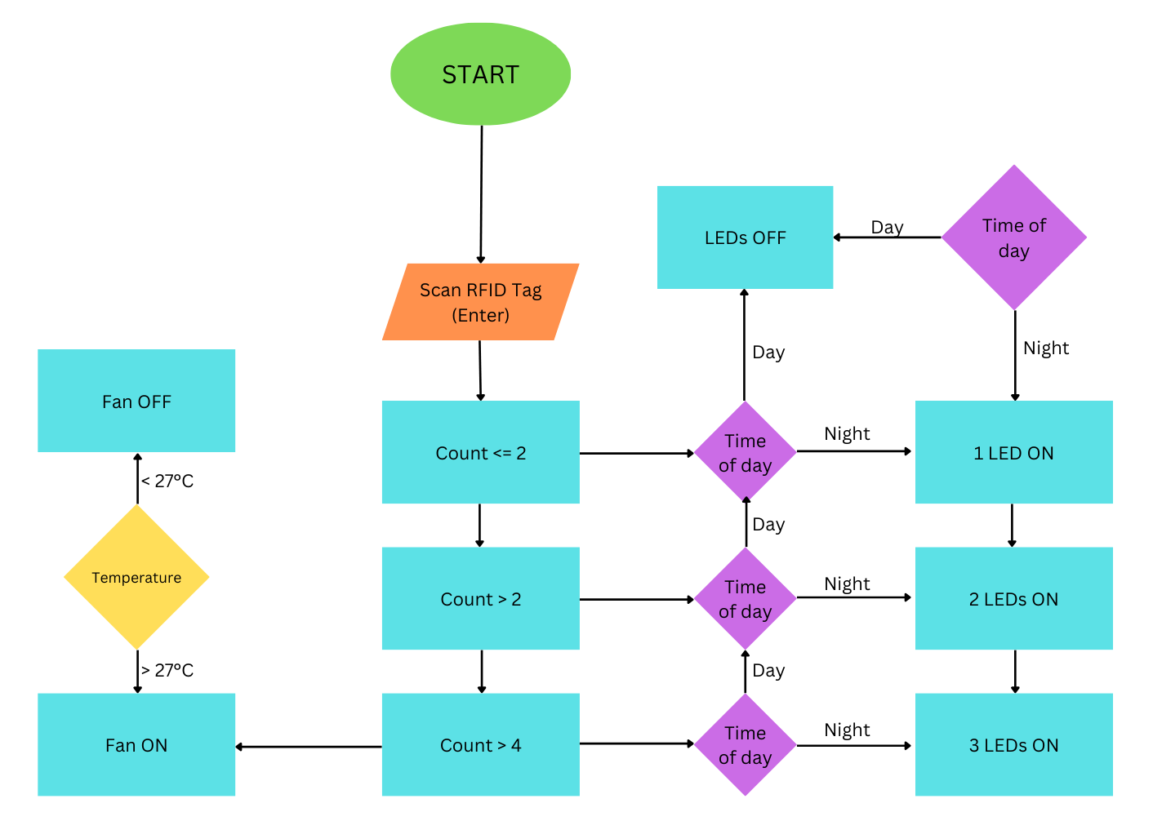

Slide 7
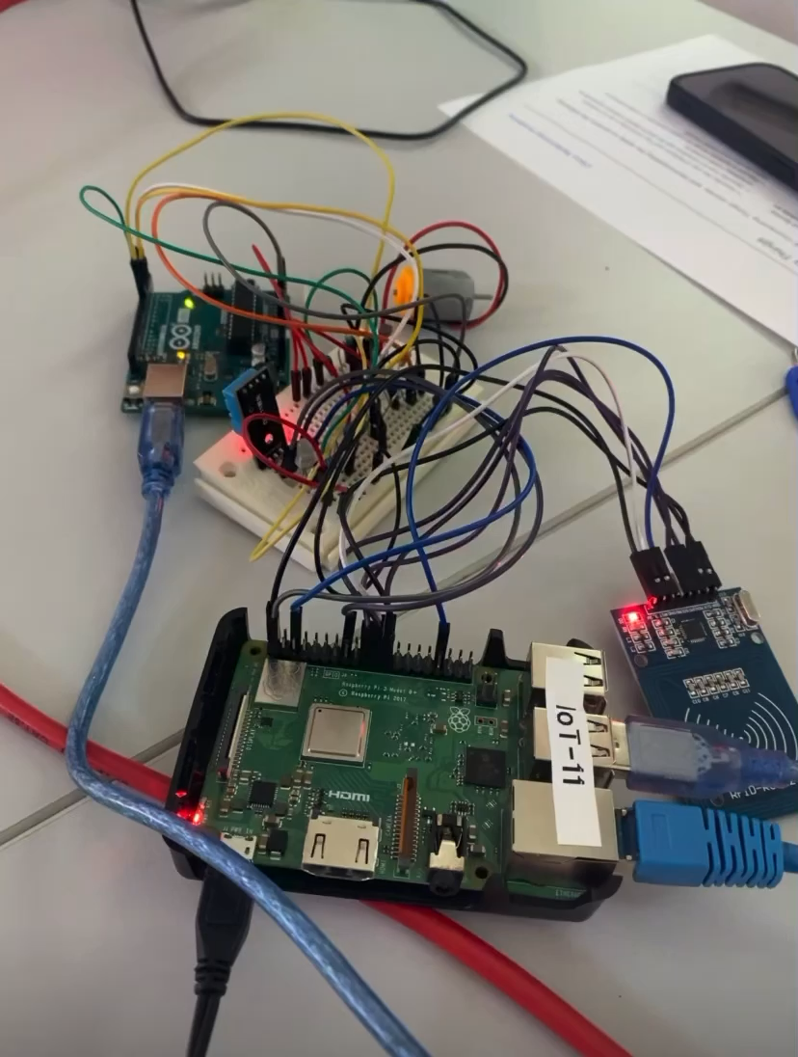
DEMONSTRATION

Slide 8
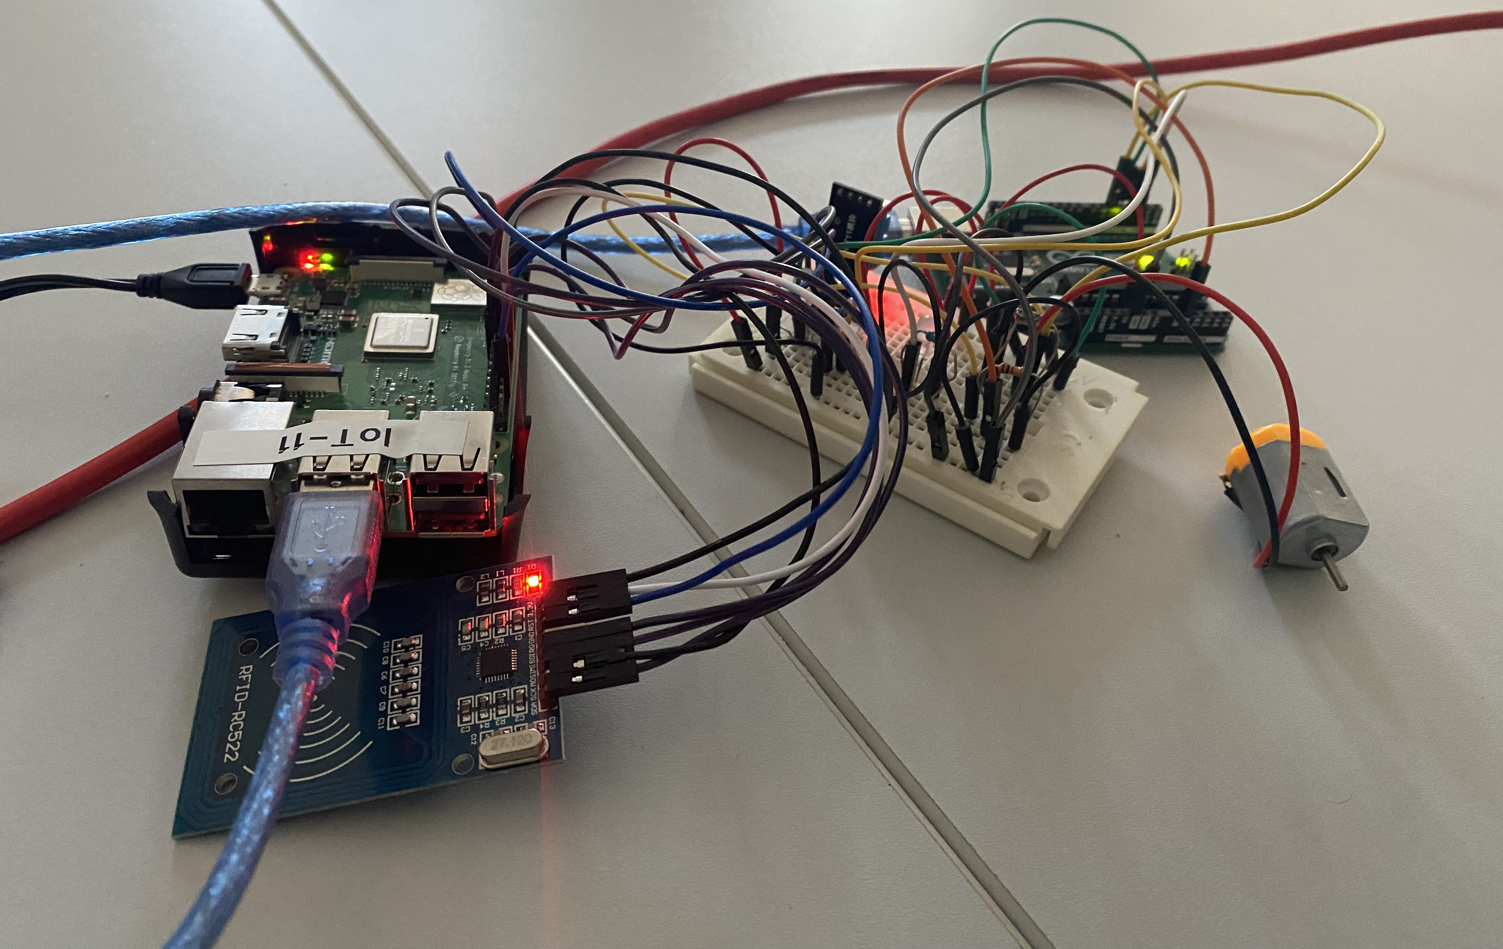

Slide 9
CLOUD INTEGRATION
Cloud integration of this project allows for remote monitoring of real-time data
Benefits of cloud integration:
Monitoring gym occupancy from anywhere
Checking and making informed decisions of gym facilities remotely
ThingSpeak Cloud API was used to provide online statistics of various parameters in the gym.

Slide 10
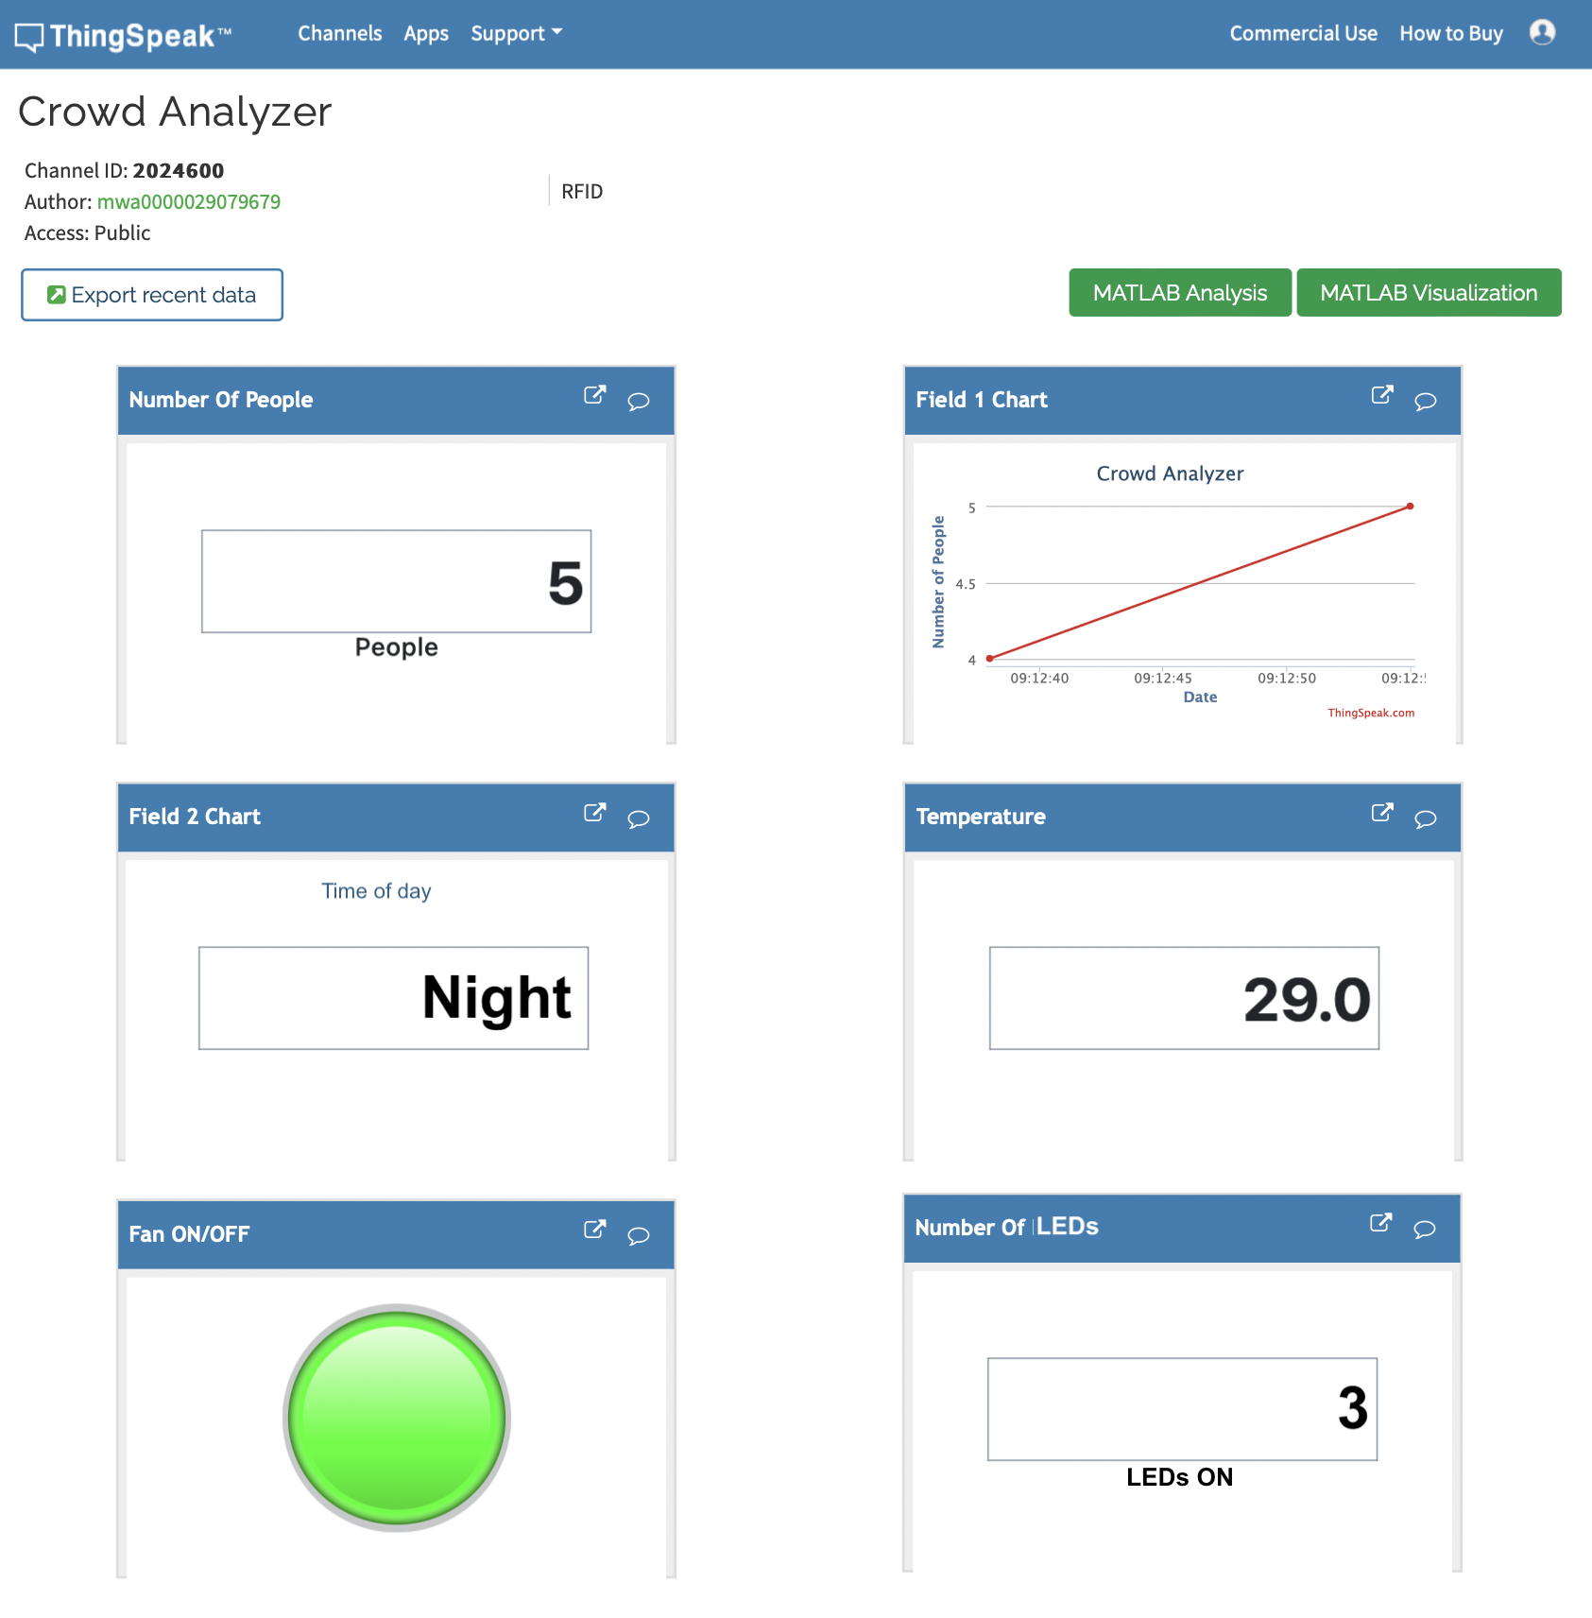

Slide 11
CHALLENGES
Incompatibility of the Cisco PL-App with MacOS
Incompatibility of the RaspberryPi interface due to dorm Wi-Fi issues
Issues with Cloud integration with live updates

Slide 12
FUTURE IMPROVEMENTS
Streamlined Entry/Exit:
2 RFID Scanners
Checking member attendance with an existing database (using SQL, etc…)
Using data analytics to provide further information (eg. Peak hours, busiest days of the week)
Personalised information for every gym member (eg. number of days attended, etc…)
Dedicated app for gym members

Slide 13
Thank You

